Slide 1
Figure S1-A

Slide 2
Figure S1-B

Slide 3
Figure S1-C

Slide 4
Figure S1-D

Slide 5
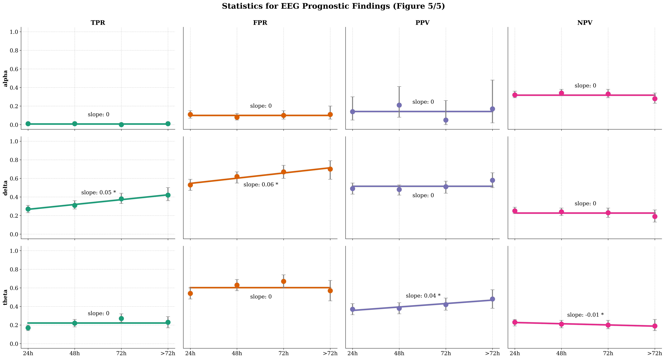
Figure S1-E

